Slide 1
Genome Databases
Mariam Quiñones, PhD

Slide 2

Today’s Instructor
Bioinformatics and Computational Biosciences Branch (BCBB), NIAID
National Institutes of Health, Bethesda, MD USA.
Contact our team via email:
Email: ace@icermali.org
Listserv: ACE-GLOBAL-ANNOUNCE@list.nih.gov
Instructor: mariam.quinones@nih.gov
Dr. Mariam Quiñones,
Ph.D. in Molecular Microbiology
Ongoing Computational Biology projects:
16S microbiome
Ion Torrent Zika virus genome assembly

Slide 3
Introduction to Genome Databases
They address the need to access and view annotated genomic data to aid in interpretation
The first major web based programs to view genomic data were the Sacharomyces (yeast) genome database and the WormBase (C. elegans genome)
Human genome databases: UCSC Genome Browser, Sanger’s Ensembl and NCBI’s Genome Data Viewer

Slide 4
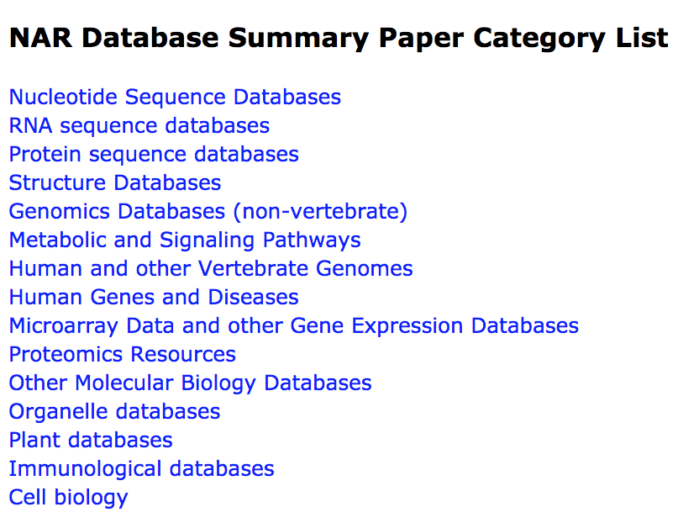
Other Biological Databases
DNA
RNA
Protein
Pathways
Variants
Plants
Immune
Metabolic
Genomes
Gene Expression
Microbes
…
View list: http://www.oxfordjournals.org/nar/database/c/

Slide 5
The reduction in sequencing costs allow increase in genome sequencing
Whole Genomes
Targeted regions
Deep sequencing
Comparative genomics
Gene expression
Epigenetics / Regulation
Metagenomics
https://www.genome.gov/27541954/dna-sequencing-costs-data/
https://www.genome.gov/images/content/costpergenome_2017.jpg
Notes:
From tens of millions of dollars to 1k

Slide 6
What can you do with genome databases?
Search for genomic features (e.g. genes, regulatory elements, transcripts)
Explore region of interest for annotations such as gene expression, histone modification, conservation across species, mutations
Use browser to upload custom tracks of data and compare with published tracks
Download sequence data in multiple

Slide 7
What else is in a Genome Browser?
With a genome browser, you display of genomic information from biological databases
Besides genome sequence, they provide additional data:
known and predicted genes
ESTs
mRNAs
CpG islands
assembly gaps and coverage
chromosomal bands
homology to other organisms
RNA-seq data
Transcription factor binding sites
GC percent
Splicing variants
Known SNPs
Associated publications
Sequence repeats
Notes:
The data added to browsers provide context for understanding genomic regions

Slide 8
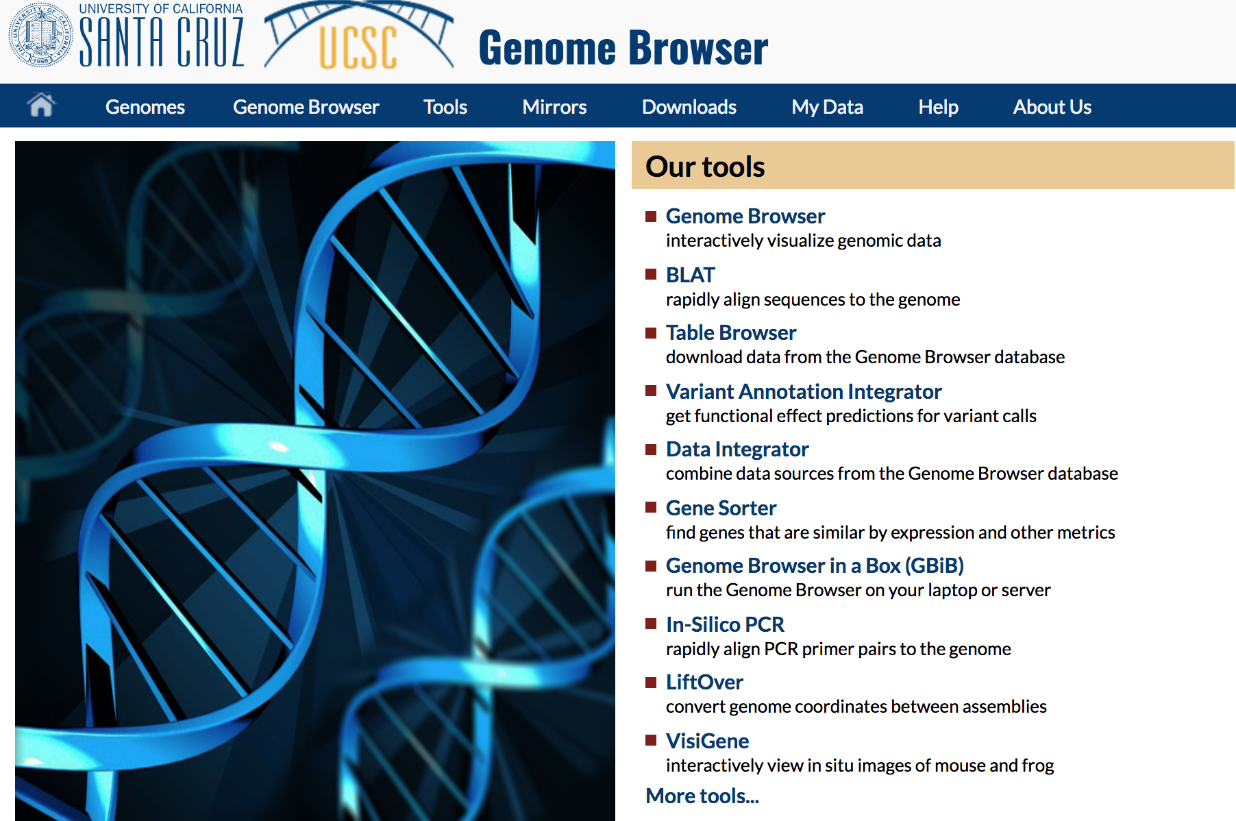
https://genome.ucsc.edu/index.html

Slide 9
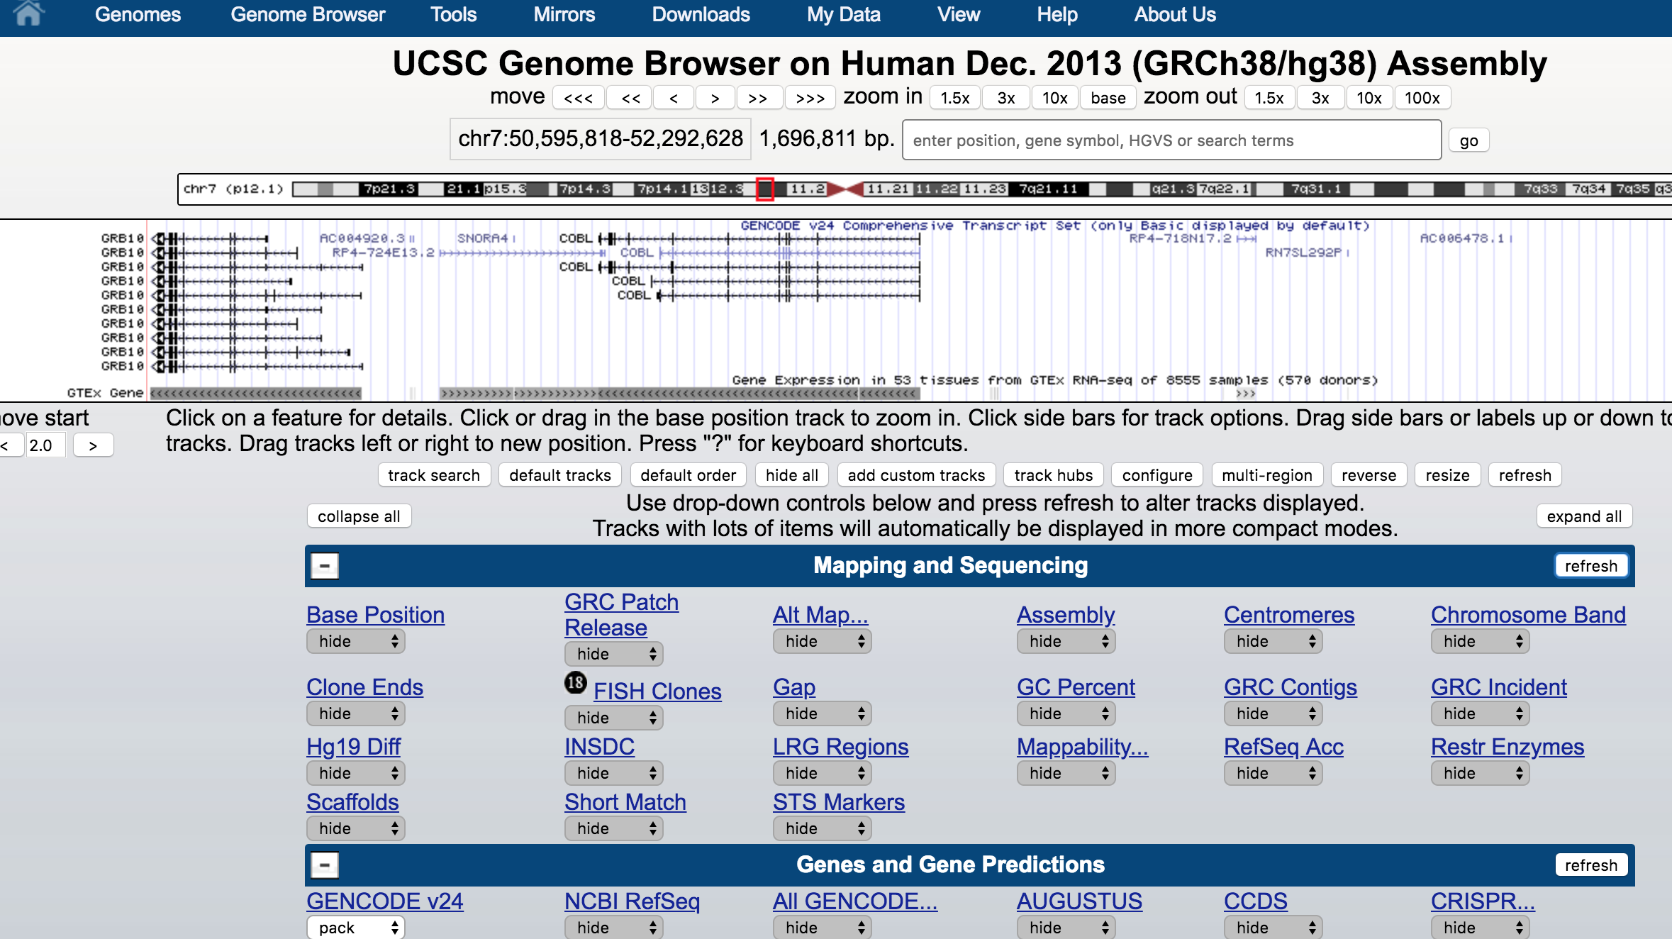
Select which tracks to display or add custom

Slide 10
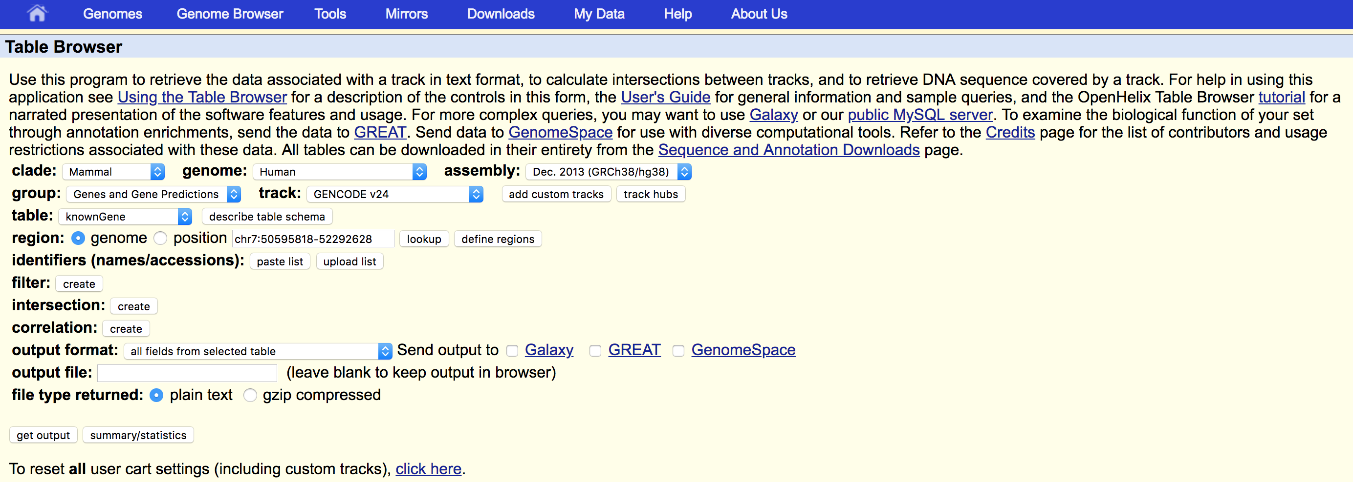
Download data using the Table Browser

Slide 11
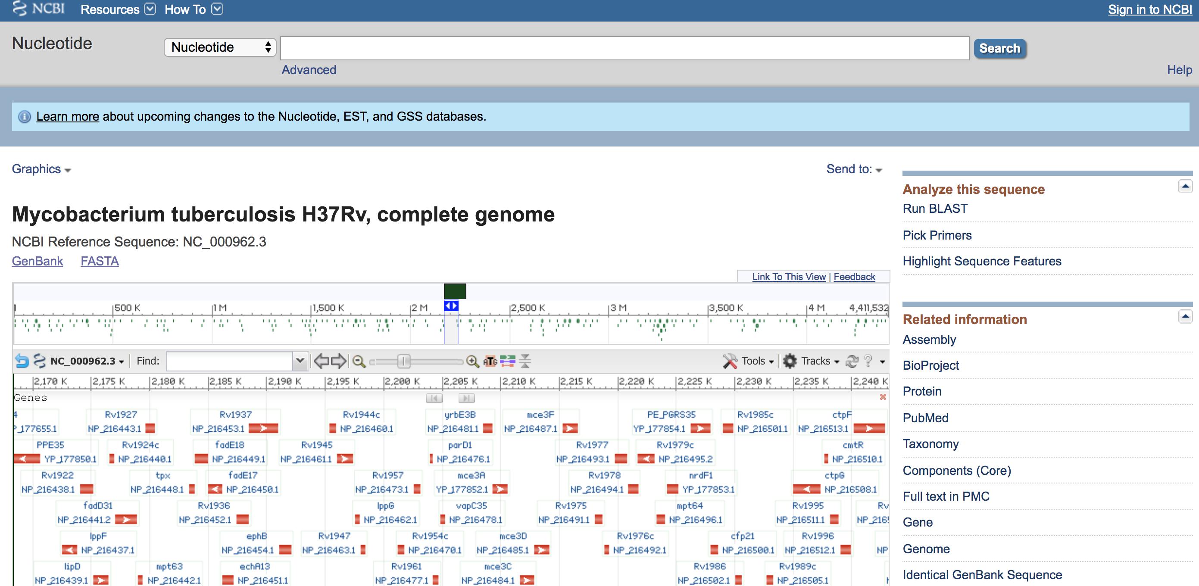
NCBI databases - https://www.ncbi.nlm.nih.gov/
Access to related tools
Links to related data
Browser integrated

Slide 12
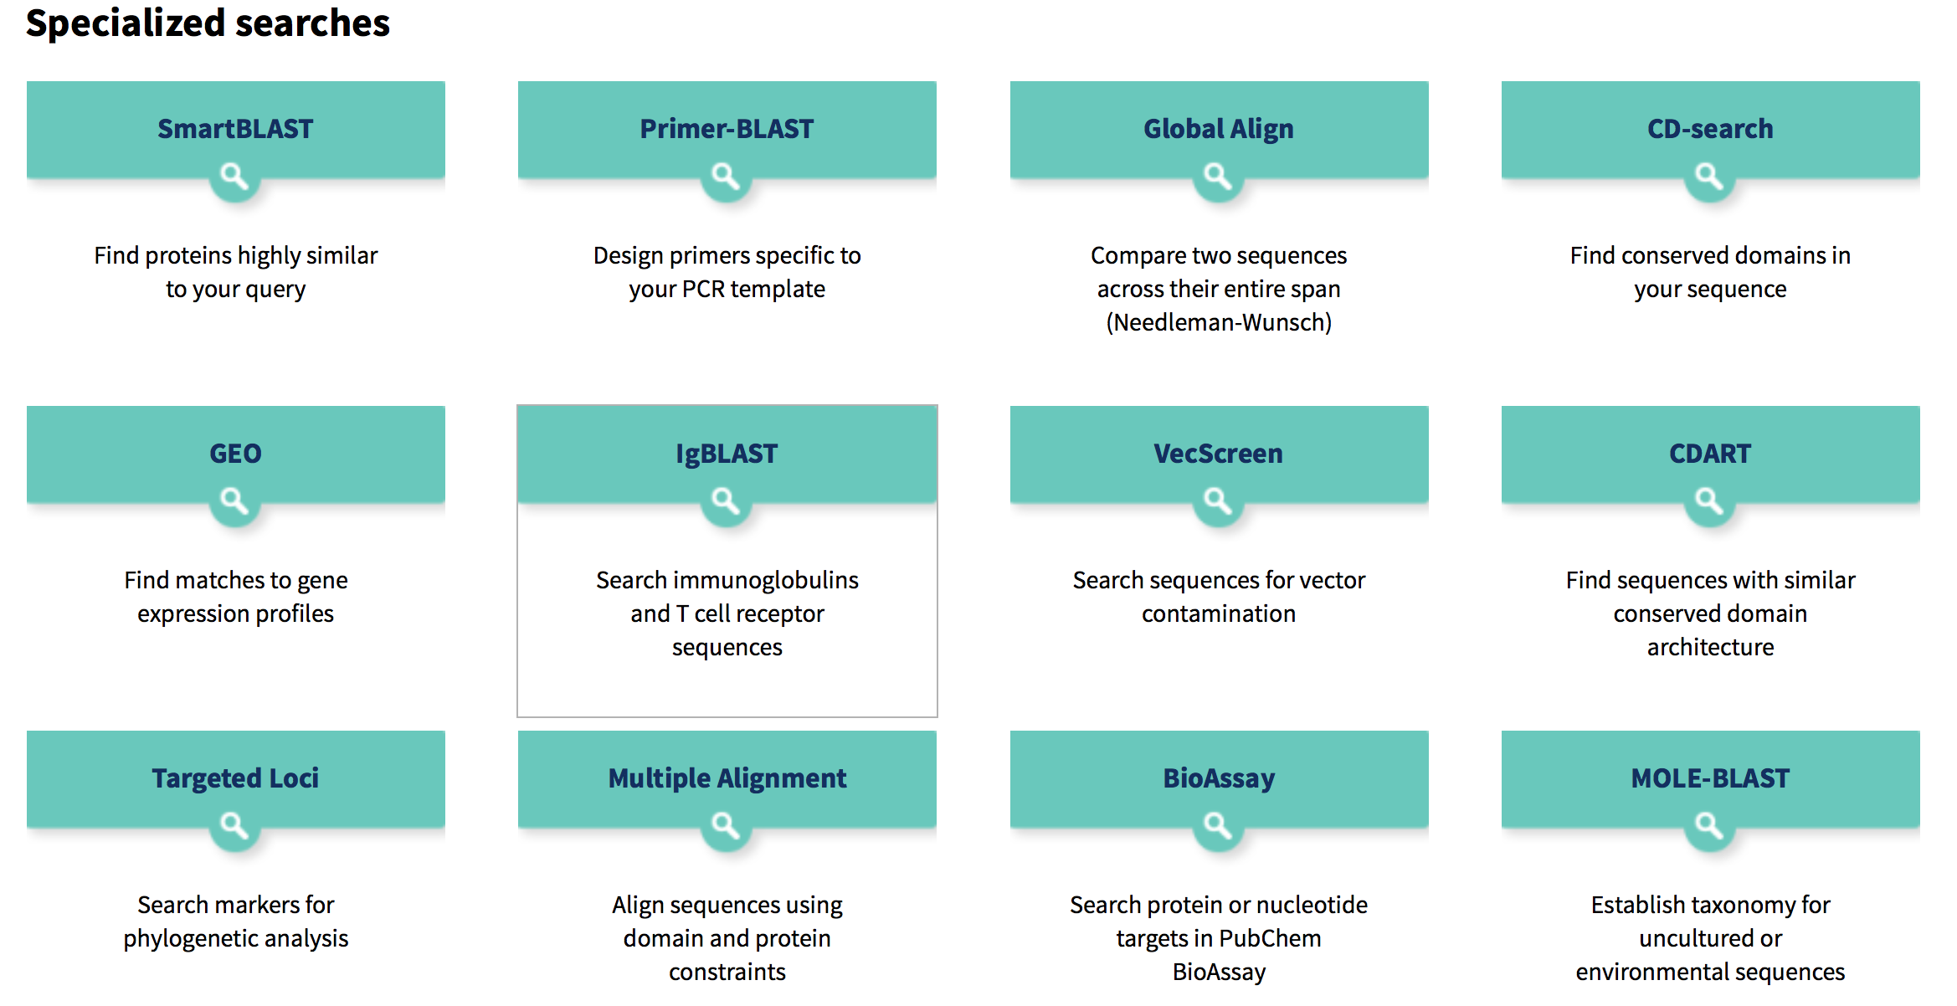
NCBI BLAST to DNA and Protein sequences
https://blast.ncbi.nlm.nih.gov/Blast.cgi
Basic Local Alignment Search Tool
Other Search Tools

Slide 13
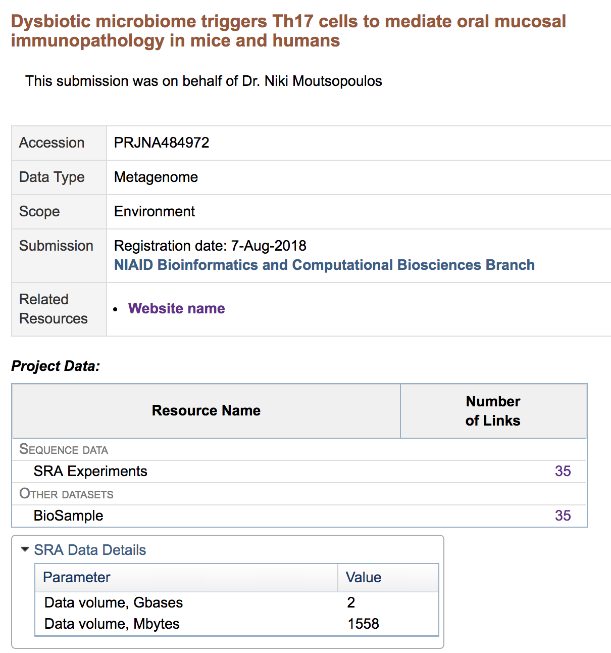
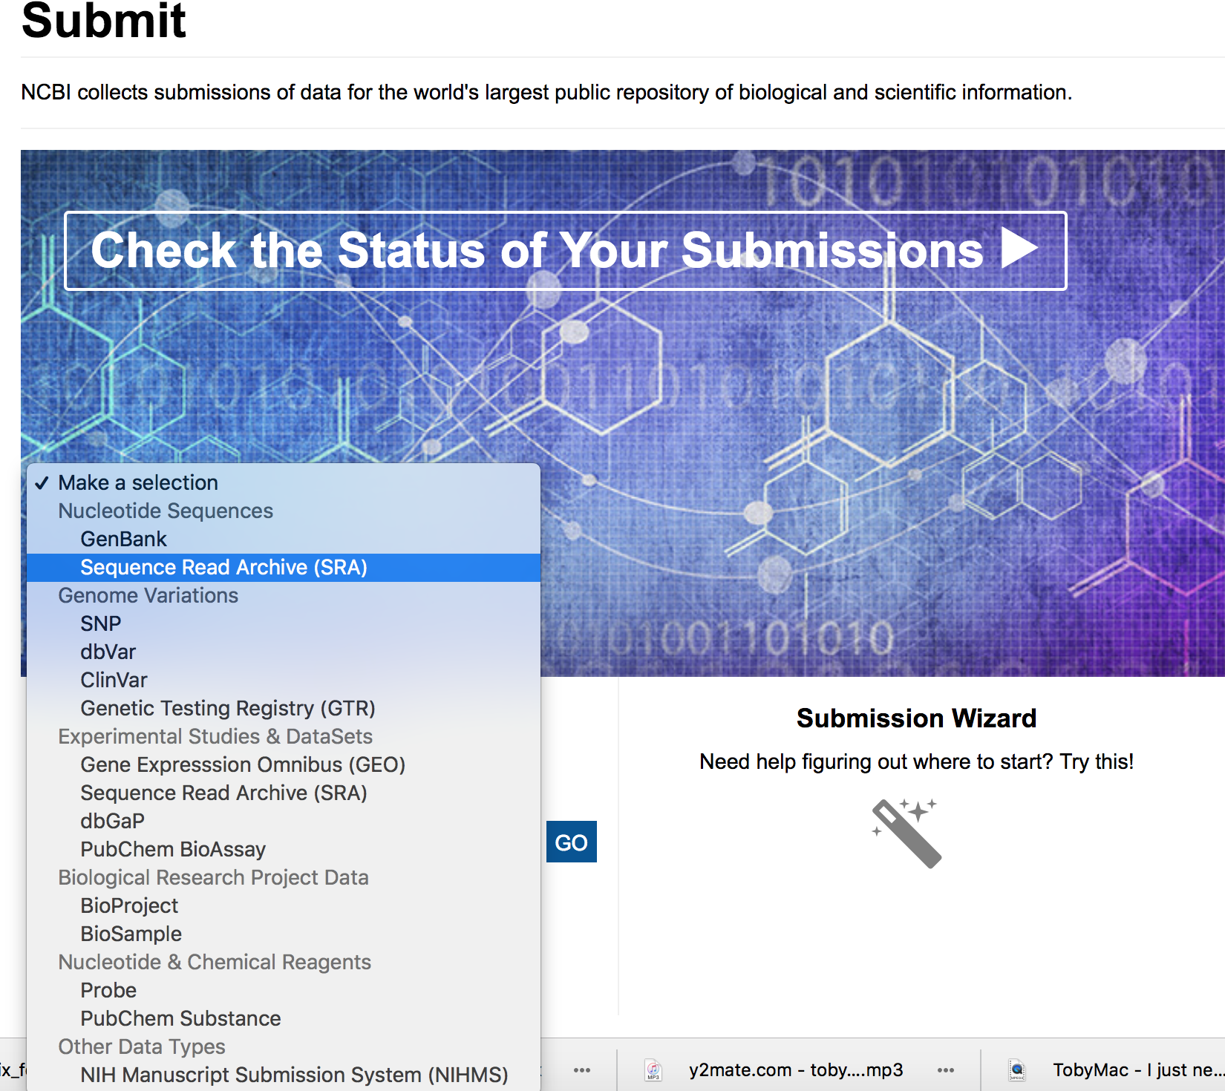
NCBI repository makes publishes your data

Slide 14
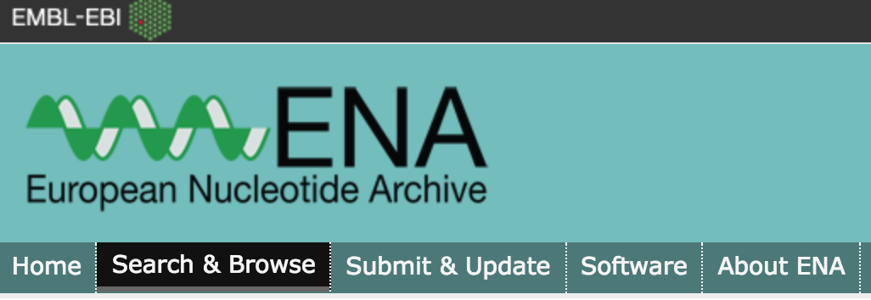
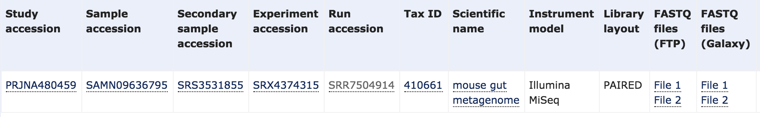
European Nucleotide Database
It mirrors NCBI SRA and allows easy download of fastq files

Slide 15
Other Specialized Genome Databases
Prokaryotes
Integrated Microbial Genomes (IGM) https://img.jgi.doe.gov
Eukaryotic Pathogens (EuPathD) https://eupathdb.org/eupathdb
Influenza:
GSAID https://www.gisaid.org
IRD https://www.fludb.org
Viruses
VIPR https://www.viprbrc.org

Slide 16
Let’s practice!
Please follow exercises provided

